Slide 1

INSTITUTE : UIE
DEPARTMENT : CSE
Bachelor of Engineering (Computer Science & Engineering)
WEB AND MOBILE SECURITY (Professional Elective-I)
(20CST/IT-333)
TOPIC OF PRESENTATION:
Attacks and countermeasures for the most popular web platforms, including IIS, Apache, PHP, and ASP.NET.
DISCOVER . LEARN . EMPOWER

Slide 2
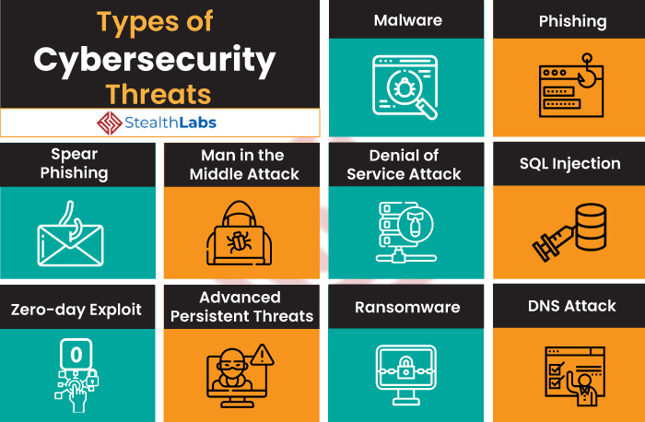
Lecture Objectives
In this lecture, we will discuss:
Attacks and countermeasures for the most popular web platforms, including IIS, Apache

Slide 3
Web Server and its Types of Attacks
Websites are hosted on web servers. Web servers are themselves computers running an operating system; connected to the back-end database, running various applications. Any vulnerability in the applications, Database, Operating system or in the network will lead to an attack on the web server. Vulnerability stack of a web server is given below (source: White hat security)
Denial-of-Service (DoS) / Distributed Denial-of-service (DDoS)
Web Defacement Attack
SSH Brute Force Attack
Cross-site scripting (XSS)
Directory Traversal
DNS Server Hijacking
MITM Attack
HTTP Response Splitting Attack
https://www.geeksforgeeks.org/web-server-and-its-types-of-attacks/

Slide 4
IIS and Apache : Attack types
1. DOS attack:
A Denial-of-Service (DoS) attack is an attack meant to shut down a machine or network, making it inaccessible to its intended users.
An attacker may cause a denial of service attack by sending numerous service request packets overwhelming the servicing capability of the web server, or he may try to exploit a programming error in the application causing a DOS attack.
e.g. buffer overflow attack, TCP SYN flooding, HTTP get Request Flooding, Ping of death.
Ping of Death (a.k.a. PoD) is a type of Denial of Service (DoS) attack in which an attacker attempts to crash, destabilize, or freeze the targeted computer or service by sending malformed or oversized packets using a simple ping command.

Slide 5
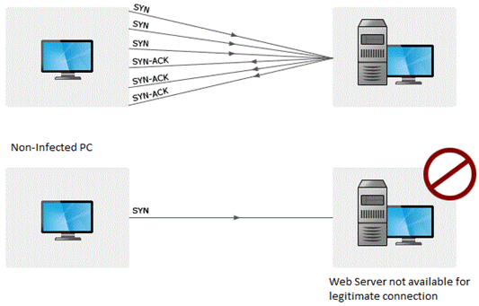

Slide 6
2. Website Defacement:
attack on a website that alters its visual appearance or informational content.
hackers use bots to automatically scan a large number of websites for vulnerabilities, and when a vulnerability is discovered, they automatically compromise and deface the site.
They generally deface a website just to take some revenge, prove their point, humiliate a government or organization, or disrupt a website's operations
To hack a website and change its content, cybercriminals can: Brute-force the credentials of the site administrator; Exploit vulnerabilities in site components; for example, performing an SQL injection (SQLi) or cross-site scripting (XSS); Infect the administrator's device with malware.
SQL injection attacks are used to deface the website. When an attacker finds out that input fields are not sanitized properly, he can add SQL strings to maliciously craft a query which is executed by the web browser. He may store malicious/unrelated data in the database; when the website is requested, it will show irrelevant data on the website, thus displaying a defaced website.

Slide 7
3. Directory Traversal:
Directory traversal is a type of HTTP exploit that is used by attackers to gain unauthorized access to restricted directories and files. Directory traversal, also known as path traversal, ranks #13 on the CWE/SANS Top 25 Most Dangerous Software Errors.
If he is able to access beyond web root directory, he might execute OS commands and get sensitive information or access restricted directories.
There are two security mechanisms that web servers use to restrict user access: root directory and Access Control Lists (ACLs). The root directory is the top-most directory on a server file system. User access is confined to the root directory, meaning users are unable to access directories or files outside of the root. Administrators use Access Control Lists to define user access rights and privileges for viewing, modifying and executing files.

Slide 8
4. Misconfiguration attacks:
Security misconfiguration occurs when security settings are not adequately defined in the configuration process or maintained and deployed with default settings .
Example. If Directory listing is not disabled on the server and if attacker discovers the same then the attacker can simply list directories to find any file and execute it.
For example, a misconfigured database server can cause data to be accessible through a basic web search. If this data includes administrator credentials, an attacker may be able to access further data beyond the database, or launch another attack on the company’s servers.
5. Phishing Attack:
An attacker may redirect the victim to malicious websites by sending him/her a malicious link by email which looks authentic, but redirects him/her to malicious web page thereby stealing their data.
There are a lot of other web application attacks which can lead to a web server attack- Parameter form tampering, Cookie tampering, unvalidated inputs, SQL injection, Buffer overflow attacks.

Slide 9
Methodology
Information Gathering: Information related to the target server is collected from various sources like
From websites
WHOIS information
Netcraft information
Spam mail
Port scanning with Nmap.
Mirroring a website using Htttrack.

Slide 10
Vulnerability Scanning:
There are automated tools for scanning a web server and applications running on it. The results may show various threats and vulnerabilities on the target web server; these vulnerabilities may later be exploited using tools or manually.
E.g. Acunetix, Nikto, Vega etc
Password Attacks:
Guessing/Default passwords
Brute Forcing
Dictionary Attacks: A dictionary attack is a method of breaking into a password-protected computer, network or other IT resource by systematically entering every word in a dictionary as a password.

Slide 11
Countermeasures
Update and patch web servers regularly.
Do not use the default configuration.
Store configuration files securely.
Scan the applications running on the web server for all vulnerabilities.
Use IDS and firewall with updated signatures.
Block all unnecessary protocols and services.
Use secure protocols.
Disable default accounts, follow strict access control policy.
Install Anti-virus, and update it regularly.
All OS and software used should be latest and updated.

Slide 12
References:
Books:
Hacking Exposed Mobile: Security Secrets & Solutions 1st Edition, Kindle Edition, by Neil Bergman, Mike Stanfield, Jason Rouse, and Joel Scambray
Hacking Exposed Web Applications, 3rd edition, Joel Scambray, Vincent Liu, Caleb Sima, Released October 2010, Publisher(s): McGraw-Hill
Video Lectures :
1https://www.simplilearn.com/tutorials/cyber-security-tutorial/types-of-cyber-attacks
2. https://intellipaat.com/blog/what-are-cyber-security-threats/
Reference Links:
1. https://developer.mozilla.org/en-US/docs/Web/Security/Types_of_attacks
2. https://www.stealthlabs.com/blog/cyber-security-threats-all-you-need-to-know/
https://www.greycampus.com/opencampus/ethical-hacking/web-server-and-its-types-of-attacks

Slide 13
THANK YOU

